Slide 1

DATA VISUALIZATION
OF
BIRD STRIKES

Slide 2
THE REASON & GOAL
Bird Strike is common and can be a significant threat to aircraft safety. For smaller aircraft, significant damage may be caused to the aircraft structure and all aircraft, especially jet-engine ones, are vulnerable to the loss of thrust which can follow the ingestion of birds into engine air intakes. This has resulted in several fatal accidents.
Airplane bird strikes, also known as bird-aircraft collisions, are a significant safety concern for the aviation industry worldwide. A bird strike occurs when a bird or birds collide with an airplane during takeoff, landing, or in-flight, causing damage to the aircraft and endangering the lives of passengers and crew. In recent years, the number of reported bird strikes has increased, partly due to an increase in air traffic, but also due to improved reporting procedures and awareness. The goal of this project is to find ways to minimise this event based on analysis performed on the provided data. This will also help make informed regulation / decisions as and where required.

Slide 3
DATA & SIGNIFICANCE
To better understand the patterns and factors contributing to airplane bird strikes, a large amount of data has been collected by aviation authorities and organizations around the world. This dataset includes information on the location, time, type of bird, and extent of damage caused by bird strikes to airplanes. This data is valuable for aviation safety researchers and practitioners, who use it to identify risk factors and develop strategies for preventing bird strikes.
This dataset contains information on airplane bird strikes from various sources, including airport reports, airline incident databases, and wildlife management programs. The data covers a range of airplane types, bird species, and geographic locations, providing a comprehensive overview of the phenomenon. By analyzing this data, we can gain insights into the frequency, severity, and causes of bird strikes, and use this information to develop effective prevention measures.

Slide 4
THE APPROACH
Perform yearly analysis and create visuals depicting the number of bird strikes.
Find the top US airlines in terms of total encountered bird strikes.
Find airports with most incidents of bird strikes.
Find yearly cost incurred due to bird strikes.
Identify when do most bird strikes occur.
Find average altitude of airplanes at the time of strike.
Define phase of flight at the time of the strike.
Identify effect of bird strikes & impact on flight.
Find effect of strike at different altitude.
Identify if the pilots informed and its effect on strike event.

Slide 5
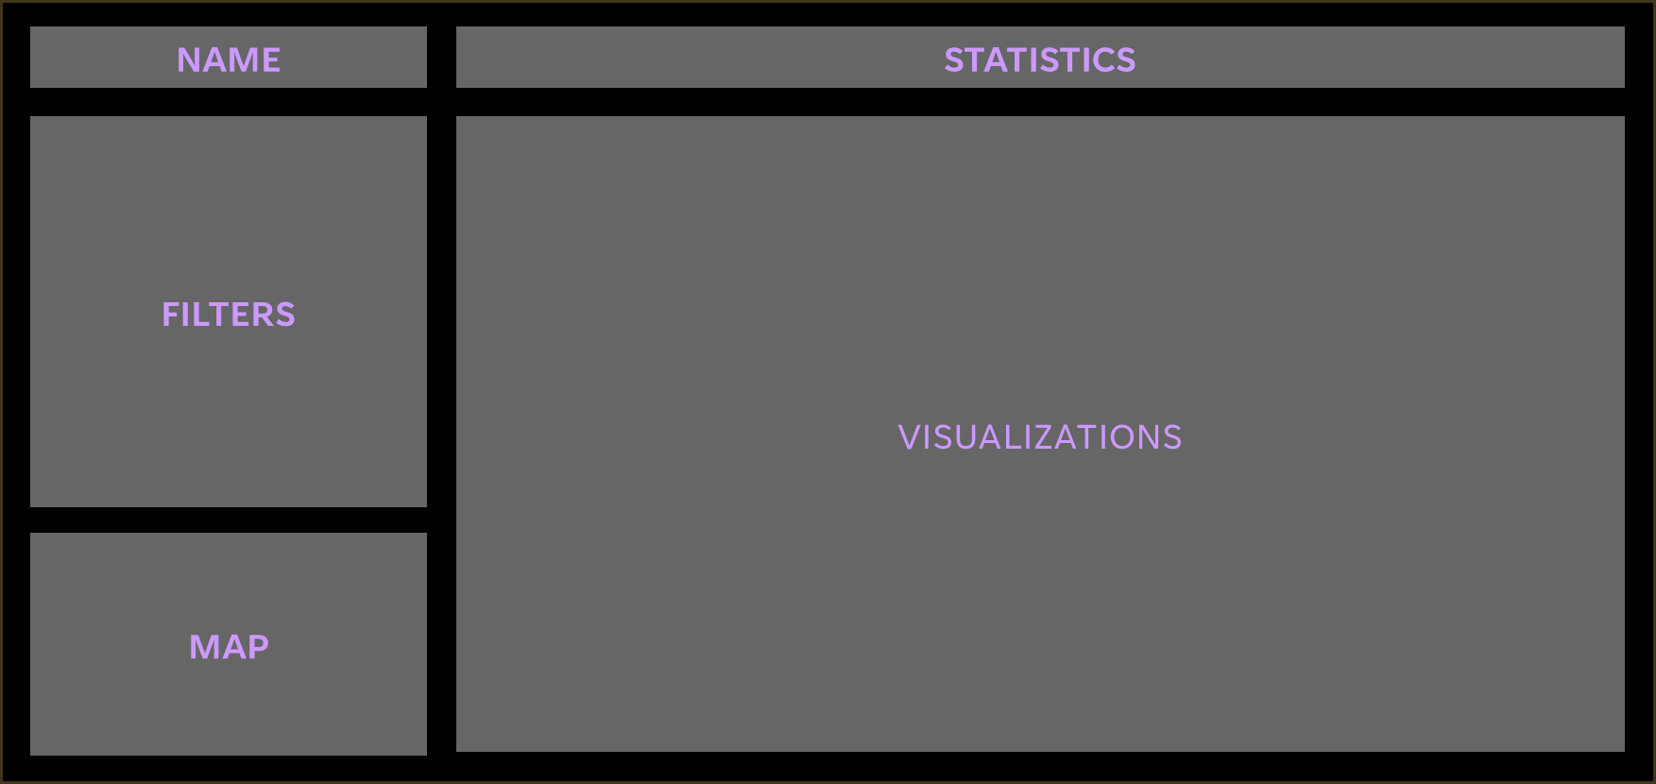
DASHBOARD WIREFRAME

Slide 6
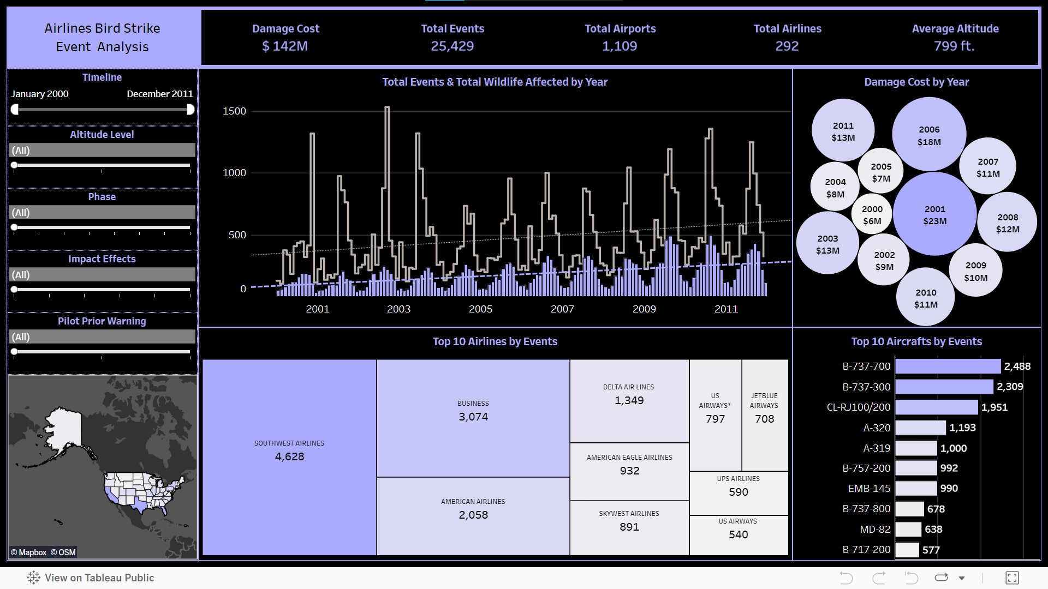
DASHBOARD

Slide 7
Analysis
The total number of strikes and wildlife affected has increased over the years with major peaks falling in the rainy season (July - September).
Southwest Airlines, Private Jets and American Airlines are among the top strike affected airlines.
2001 was the year where airlines incurred the most damage cost followed by 2006, 2003 and 2011.
Boeing aircrafts like the B-737, B-757 and B-717 are among the top aircrafts affected by bird strikes.
Most events took place in the southern and eastern US states; Texas, California and Florida being among the top three.
Number of strike events and total wildlife affected are positively correlated.
Most events took place below 1000 ft. while departure or landing.
Take-off-run and approach are the leading phases contributing to these events.
Most of the time there is no effect but occasionally the take-off is aborted.
Informing / warning the pilot significantly reduces the number of strikes, total wildlife affected and damage cost.

Slide 8
THANK YOU
Tools:
Tableau.
Excel.
GitHub.
Adarsh Niranjan​​
adi.singh.niranjan@gmail.com
https://github.com/adarsh-niranjan
https://www.linkedin.com/in/adarshniranjan/

